Slide 1
Chapter 1 The Fundamentals: Logic and Proofs
Section 1
Propositional Logic(命题逻辑)
陈炬桦：isscjh@mail.sysu.edu.cn
作业：cconline.sysu.edu.cn

Slide 2
Propositional logic
Understand and construct correct mathematical arguments
Give precise meaning to mathematical statements
Rules are used to distinguish between valid (true) and invalid arguments
Used in numerous applications: circuit design, programs, verification of correctness of programs, artificial intelligence, etc.

Slide 3
Outline(概要)
Introduction to Logic and Proofs
Propositions
Logical Connectives (连接词)
Truth Tables
Conditional Statements
Construction of Compound Propositions
Translating Sentences into Proposition Logic
*Applications of Propositional Logic

Slide 4
Logic and Proofs
Logic
  Logic is the basis of all mathematical & automated reasoning(推理). The rules of logic specify the meaning of mathematical statements.
  Logic is applied to the design of computing machines, the specification of systems(规范的系统), computer programming,…

Slide 5
Logic and Proofs
Proof
  A proof is a correct mathematical argument(论证)
  We need to construct mathematical arguments on a mathematical topic which is a collection of theorems (some statements proving to be true).
  Proofs play an essential role in the development of new ideas. Knowing the proof of a theorem makes it possible to modify the result to fit new situation.

Slide 6
Logic and Proofs
We will learn
  What makes up a correct mathematical argument
    Propositions, Predicates, and Quantifiers(谓词和量词)
    Rules of inference(推理) for propositions and quantified statements
  The tools to construct proofs
    Some different proof methods
      Direct proof; proof by contraposition(对置); proof by contradiction (反证法)
    Some strategy for constructing proofs
      Exhaustive proofs; proof by cases; existence proofs; uniqueness proofs; forward and backward reasoning; looking for counterexamples.

Slide 7
Logic and Proofs
Learning logic and proofs, we can
  Understand and construct correct mathematical arguments
  Give precise meaning to mathematical statements
  Rules are used to distinguish between valid (true) and invalid arguments
  Used in numerous applications: circuit design, programs, verification of correctness of programs, artificial intelligence, etc.

Slide 8
Propositions
Proposition (命题)
  A proposition is a declarative sentence(陈述句) that is either true or false, but not both.
  Examples
    Washington, D.C., is the capital of USA
    California is adjacent to New York
    1+1=2
    2+2=5
    What time is it?
    Read this carefully
    x+1=2

Slide 9
EXAMPLE 1
All the following declarative sentences are propositions.
1. Washington, D.C., is the capital of the United States of America.
2. Toronto is the capital of Canada.
3. 1 + 1 = 2.
4. 2 + 2 = 3.
Propositions 1 and 3 are true, whereas 2 and 4 are false.

Slide 10
EXAMPLE 2 Consider the following sentences.
1. What time is it?
2. Read this carefully.
3. x + 1 = 2.
4. x + y = z.
Sentences 1 and 2 are not propositions because they are not declarative sentences.
Sentences 3 and 4 are not propositions because they are neither true nor false.

Slide 11
Propositions
Primitive proposition (原子命题)
  A primitive or simple proposition is a proposition that does not contain any other proposition as its component (also called an atom)
  Examples
    California is adjacent to New York
    John and Peter are brothers
    It is Friday and it is raining
    It is a rainy Friday

Slide 12
Propositions
Propositional variable (命题变量)
  When the meaning of a primitive proposition in the real world is unconcerned（无关）, it can be represented by a propositional variable, denoted simply by letters of p, q, r, ….
  Examples
    California is adjacent to New York
  denoted by p : California is adjacent to New York
    John and Peter are brothers
  denoted by q : John and Peter are brothers

Slide 13
Propositions
Truth Value (命题真值)
  Symbolic T is used to denote TRUE, and F to denote FALSE
Propositional Logic (命题逻辑)
  Propositional Logic or Propositional Calculus is the area of logic that deals with propositions
Compound propositions (复合命题)
  A compound proposition contains other propositions as its components
  It is formed from its components of propositions using logical operator (s), or called logical connectives

Slide 14
Logical operators
Logical operators/connectives (逻辑连接词)
  Negation ¬ / ~ (NOT, 否定/非)
  Conjunction ∧ / & (AND, 合取/与)
  Disjunction ∨ / || (OR, 析取/或)
  Conditional statement → / ⊃ (Implication, 蕴含/条件)
  Biconditional statement ↔ / ≡ (XNOR/IFF, Bi-implication,双重蕴含/双条件)
  Exclusive Or ⊕ (XOR, 异或/不可兼或)
  NAND ↑ / | (Sheffer stroke, 与非)
  NOR ↓ (Peirce's arrow, 或非)

Slide 15
Negation
Examples
  Negation of “Today is Friday”
    It is not the case that today is Friday
    Today is not Friday
  Negation of “At least 10 inches of rain fell today in Miami”
    It is not the case that at least 10 inches of rain fell today in Miami
    Less than 10 inches of rain fell today in Miami

Slide 16
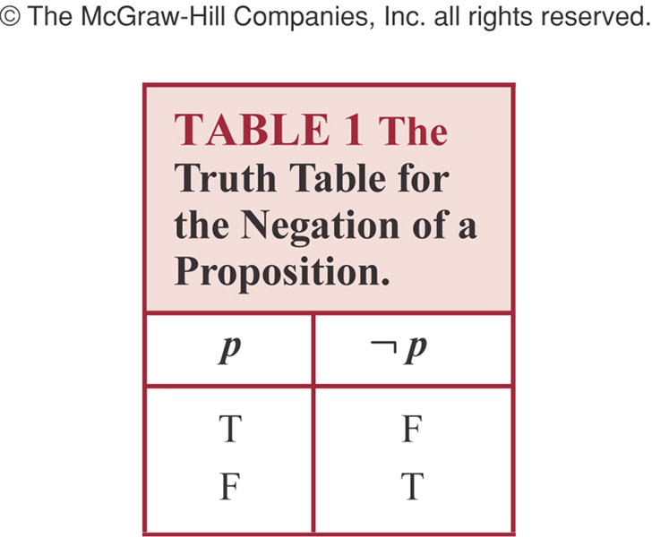
Negation
Negation:
  ¬p is true when p is true.

Slide 17
Negation
Truth Table of logical operators
  The logical meaning of a logical operator can be described (semantically) by a truth table.
  Columns of the table
    The most-right column corresponds to the connection
    Each column corresponds to one propositional variable of the components
  Rows of the table
    Each row corresponds to one combination of truth values of all the columns (a logical interpretation), and the most-right value describes the logical result of the operation on such interpretation
    2^{n} rows contained for n propositional variables

Slide 18
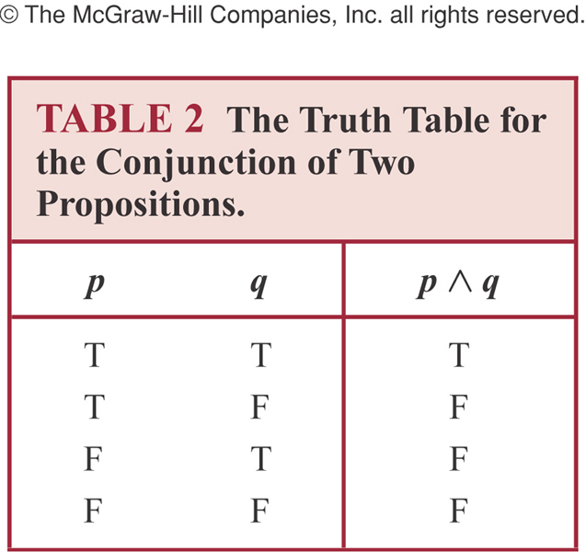
Conjunction
Conjunction:
  p∧q is true when both p and q are true.
  False otherwise

Slide 19
Conjunction
Example
  p : “Today is Friday”
  q: “It is raining today”
  p∧q : “Today is Friday and it is raining today”
    True: on rainy Fridays
    False: otherwise,
      For any day that is not a Friday
      For Fridays when it does not rain

Slide 20

Disjunction
Disjunction:
  p∨q is false when both p and q are false.
  True otherwise

Slide 21
Disjunction
Example
  p : “Today is Friday”
  q: “It is raining today”
  p∨q: “Today is Friday or it is raining today”
    True:
      Today is Friday
      It is raining today
      It is a rainy Friday
    False
      Today is not Friday and it does not rain

Slide 22
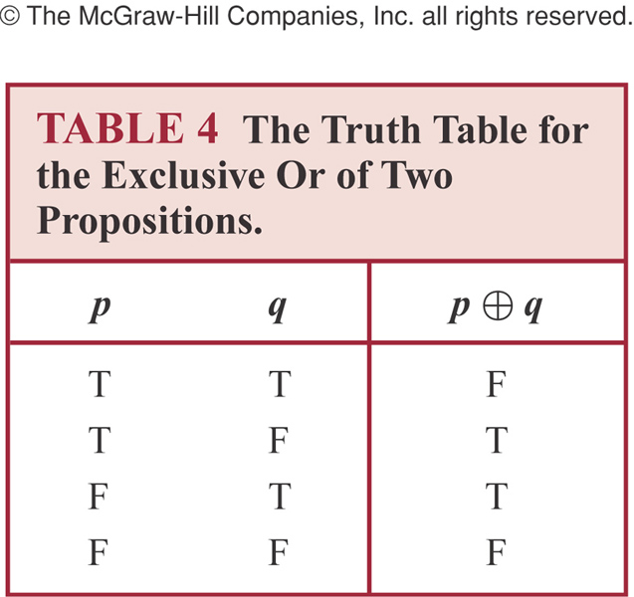
Exclusive or
Exclusive Or:
  p⊕q is true when exactly one of p, q is true.
  False otherwise

Slide 23
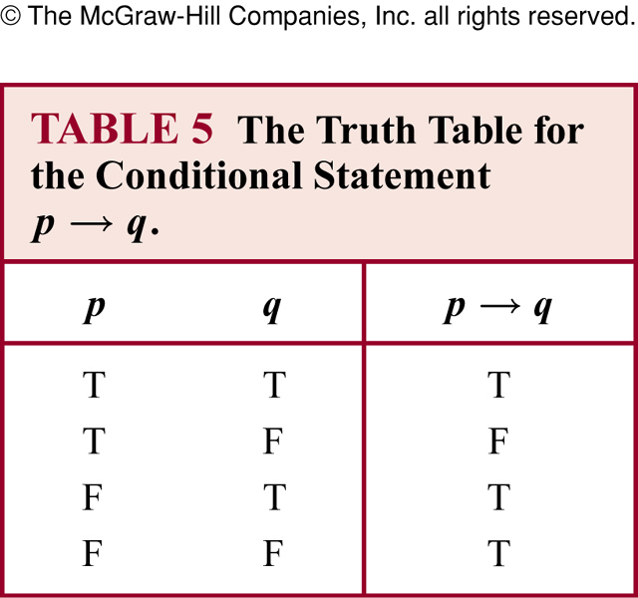
Conditional statement
Conditional Statement
  also called an implication
  p→q is false when p is true and q is false.
  True otherwise

Slide 24
Conditional statement
Example
  p: you go, q: I go. p→q means
    “If you go, then I go”
    “You go only if I go” or “If I don’t go, then you don’t go”
    not the same as “If I go only if you go”
  Some equivalent expressions for p→q
if p, then q | p implies q
if p, q | p only if q
p is sufficient for q | A sufficient condition for q is p
q if p | q whenever p
q when p | q is necessary for p
A necessary condition for p is q q unless not p | q follows from p

Slide 25
Conditional statement
Example
  “If Maria learns discrete mathematics, then she will find a good job” means:
    Maria will find a good job when she learns discrete mathematics (q when p)
    For Maria to get a good job, it is sufficient for her to learn discrete mathematics (sufficient condition for q is p)
    Maria will find a good job unless she does not learn discrete mathematics (q unless not p)
Common mistake
  For p→q
    Correct: p only if q (It follows the semantic of “If not q then not p)
    Mistake to think “q only if p”

Slide 26
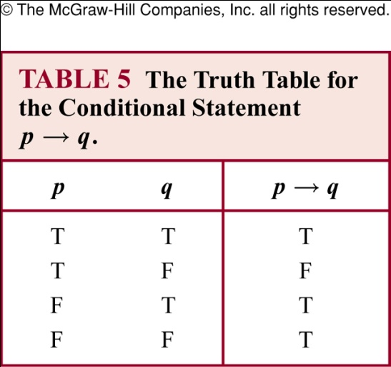
Conditional statement
Example
  “If today is Friday, then 2+3=6”
    The statement is true every day except Friday even though 2+3=6 is false

Slide 27
Converse, contrapositive and inverse
Converse (逆命题) for p→q
  q→p
Contrapositive (逆否(反)命题) for p→q
  ¬q→ ¬p
  Contrapositive and conditional statements are equivalent
Inverse (否(反)命题) for p→q
  ¬p→¬q

Slide 28
Converse, contrapositive and inverse
Converse of an implication
  Implication: p → q
  Converse: q → p
  Implication:
    If I am going to town, then it is raining.
  Converse:
    If it is raining, then I am going to town.

Slide 29
Converse, contrapositive and inverse
Contrapositive of an implication
  Implication: p → q
  Contrapositive: ¬q → ¬p
  Implication:
    If I am going to town, then it is raining.
  Contrapositive:
    If it is not raining, then I am not going to town.
  The contrapositive has the same truth table as the original implication

Slide 30
Converse, contrapositive and inverse
Inverse of an implication
  Implication: p → q
  Inverse: ¬p → ¬q
  Implication:
    If I am going to town, then it is raining.
  Inverse:
    If I am not going to town, then it is not raining.
  The inverse of an implication has the same truth table as the converse of that implication

Slide 31
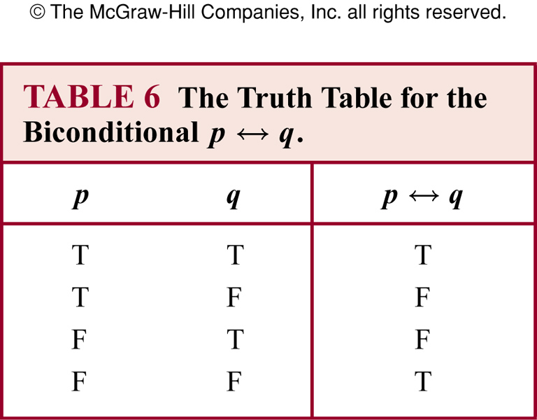
Biconditional statement
Biconditional Statement
  Also called a bi-implication
  “p if and only if q”
  p↔q is true when p, q have the same truth value.
  False otherwise

Slide 32
Biconditional statement
Example
  p: “you can take the flight”
  q: “you buy a ticket”
  p↔q: “You can take the flight if and only if you buy a ticket”
  This statement is true
    If you buy a ticket and take the flight
    If you do not buy a ticket and you cannot take the flight

Slide 33
Construction of Compound Propositions
Well-formed Formula (Wff, 合式公式)
  In mathematical logic, a well-formed formula, shortly wff, often simply formula, is a word (i.e. a finite sequence of symbols from a given alphabet) that is part of a formal language. A formal language can be considered to be identical to the set containing all and only its formulas.
  A wff is a syntactic formal object that can be informally given a semantic meaning.
  In propositional logic, a formula is a string of symbols ϕ for which it makes sense to ask "is ϕ true?", once any free variables in ϕ have been instantiated.
  In formal logic, proofs can be represented by sequences of formulas with certain properties, and the final formula in the sequence is what is proven.

Slide 34
Construction of Compound Propositions
Well-formed Formula (Wff)
  The wffs are inductively defined as follows:
    Each propositional variable is, on its own, a formula.
    If ϕ is a formula, then ¬ϕ is a formula.
    If ϕ and ψ are formulas, and • is any binary connective, then (ϕ •ψ) is a formula. Here • could be (but is not limited to) the usual operators ∧, ∨, →, or ↔.
    A string of symbols ϕ is a wff only if it is formed by applying rules 1~3 in finite times.

Slide 35
Construction of Compound Propositions
Well-formed Formula (Wff)
  The definition of wffs in Backus–Naur form:
    <alpha set> ::= p | q | r | s | t | u | ... (the arbitrary finite set of propositional variables)
    <form> ::= <alpha set> | ¬ <form> | (<form> ∧ <form>) | (<form> ∨ <form>) | (<form> → <form>) | (<form> ↔ <form>).
  A compound proposition can be transferred into a wff by making use of the above definition properly.

Slide 36
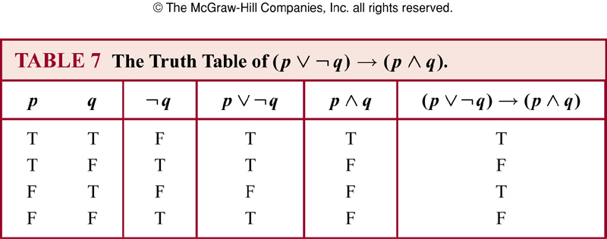
Truth table of compound propositions
Example
  Truth table of compound propositions

Slide 37
Truth table of compound propositions
Remark
  Truth table can be used to determine the truth value of a compound proposition
  A separate column is used to find the truth value of each compound expression that occurs in the compound proposition as it is built up according to the definition of wff.
  The final values of the compound proposition on every logical interpretation are shown in the most-right column
  The table is built up column by column

Slide 38
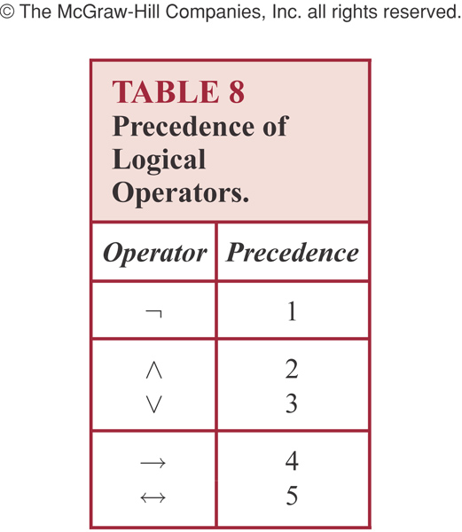
Precedence of logic operators
Parentheses gets the highest precedence. Then:

Slide 39
Precedence of logic operators
Examples
  p ∧ q ∨ r means (p ∧ q) ∨ r, not p ∧ (q ∨ r)
  p ∨ q → r means (p ∨ q) → r

Slide 40
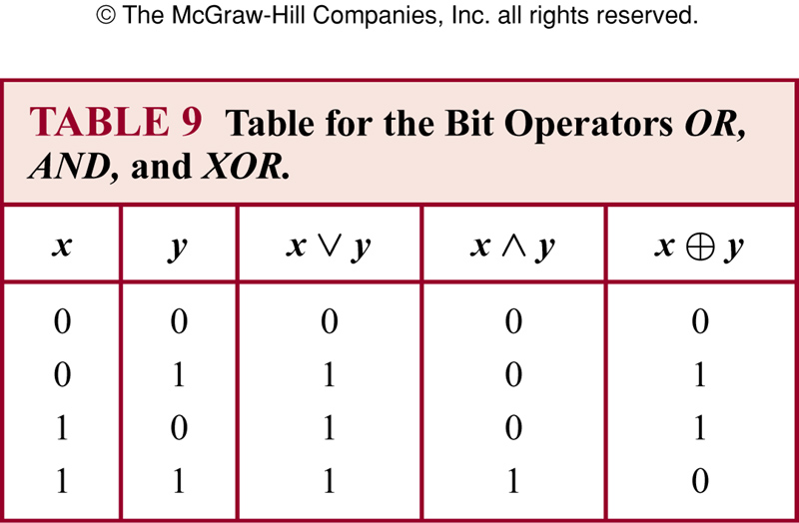
Bit operations

Slide 41
Translating English to logical expressions
Why translating?
  As a human language, English is often ambiguous and translating sentences into compound propositions removes the ambiguity
  Using logical expressions, we can analyze them and determine their truth values. And we can use rules of inferences to reason about them

Slide 42
Translating English to logical expressions
Example
  “ You can access the internet from campus only if you are a computer science major or you are not a freshman.”
  Solution:
    p : “You can access the internet from campus”
    q : “You are a computer science major”
    r : “You are freshmen”
    p → ( q∨¬r )

Slide 43
Translating English to logical expressions
Example (System Specification)
  Translating sentences in natural language into logical expressions is an essential part of specifying both hardware and software systems.
  Consistency of system specification.
    They could not contain conflicting requirements that could be used to derive a contradiction
    The compound proposition represented the specification can be true (also known as being satisfiable, i.e., it gets a value of TRUE upon some interpretation)

Slide 44
Translating English to logical expressions
Example (System Specification)
  Express the specification “The automated reply cannot be sent when the file system is full”
  Solution
    Let p denote “The automated reply can be sent”
    Let q denote “The file system is full”
    The logical expression for the sentence “The automated reply cannot be sent when the file system is full” is
    q → ¬p

Slide 45
Translating English to logical expressions
Example (System Specification)
  Determine whether the following system specifications are consistent:
    The diagnostic message is stored in the buffer or it is retransmitted.
    The diagnostic message is not stored in the buffer.
    If the diagnostic message is stored in the buffer, then it is retransmitted.

Slide 46
Translating English to logical expressions
  Solution
    Let p denote “The diagnostic message is stored in the buffer”
    Let q denote “The diagnostic message is retransmitted”
    The three specifications are
    p ∨ q, ¬p, p→q
    The proposition (p∨q)∧(¬p)∧(p→q) can be true when p is false and q is true.
    Consequently, the specifications are consistent.

Slide 47
Translating English to logical expressions
Example (System Specification)
  Determine whether the following system specifications are consistent:
    The diagnostic message is stored in the buffer or it is retransmitted.
    The diagnostic message is not stored in the buffer.
    If the diagnostic message is stored in the buffer, then it is retransmitted.
    The diagnostic message is not retransmitted

